Slide 1
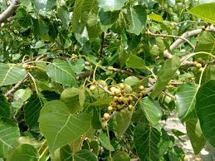
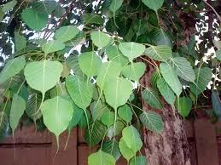
Peepal Tree
Near Assembly point 2 area AIS Campus, Wakad.

Slide 2
Common Name : Peepal
Scientific Name : Ficus religiosa
Family Name : Moraceae
Habit : The peepal tree has habit for its expansive canopy
and heart-shaped leaves.
Distribution : The peepal tree is widely distributed across tropical
and subtropical regions of South and Southeast
Asia.

Slide 3
Description
The peepal tree is a large, deciduous tree characterized by its broad, heart-shaped leaves with a distinctive pointed tip.
It features a spreading canopy with dense foliage and produces small, inconspicuous flowers.
The tree has a thick, rough bark.

Slide 4
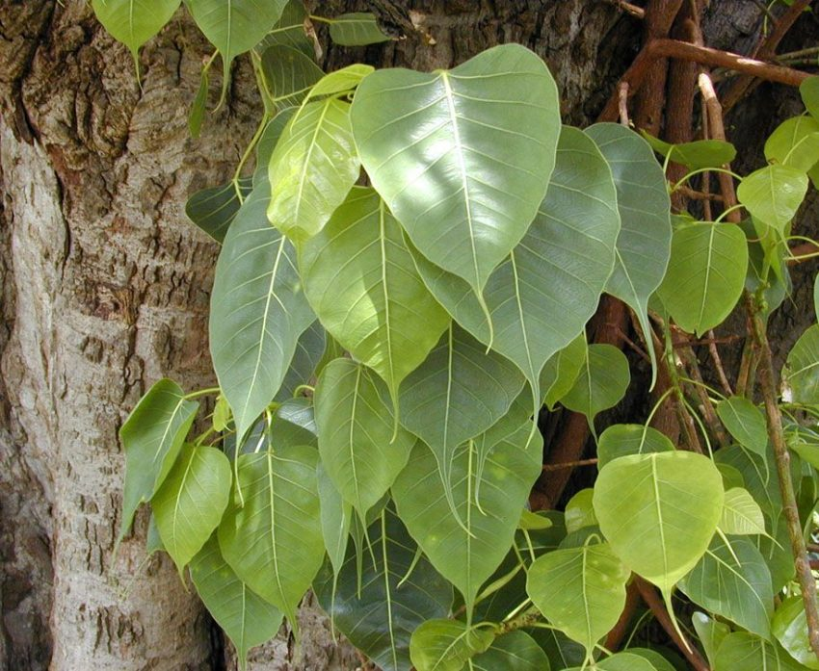

Uses

Slide 5
Religious Significance: It is revered in Hinduism and Buddhism, often
associated with spiritual practices and worships.
Medicinal: Its leaves and bark are used in traditional medicine for their
anti-inflammatory, antimicrobial, and digestive properties.
Ecological Support: It supports local wildlife by providing habitat and
food for various species of birds and insects.
Crafting: Its wood is used for making furniture, and its leaves are
sometimes used in traditional crafts and art.

